Slide 1
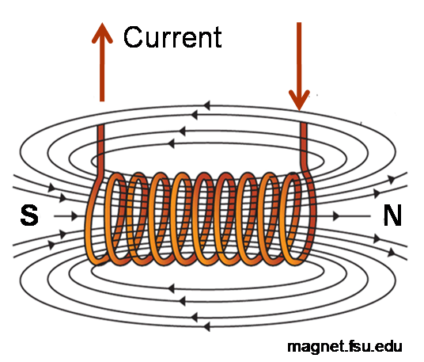
Section 10: Sources of Magnetic Field

Slide 2

What causes magnetic fields?

Slide 3

Magnetic Field of a Steady Current: The Law of Biot and Savart
$$\vec{B}=\frac{μ_{0}}{4π}\int{\frac{Id\vec{l}×\hat{r}}{r^{2}}}$$
This is exact for a constant (steady) current

Slide 4

The Proportionality Constant
$$μ_{0}=4π×{10}^{−7} \text{T}·\text{m}\text{/}\text{A}$$
Something to think about for later:
$$\frac{1}{\sqrt{ε_{0}μ_{0}}}=2.99×{10}^{8}{\text{m}}/{\text{s}}$$

Slide 5
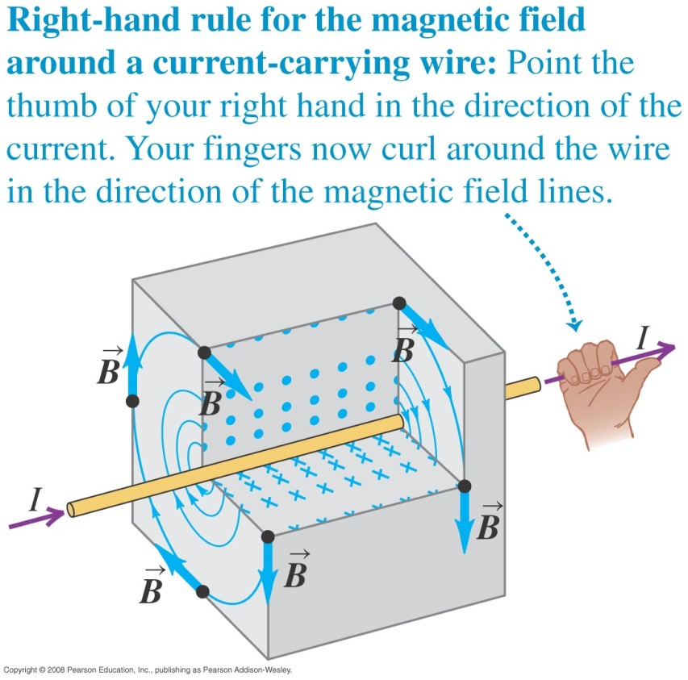
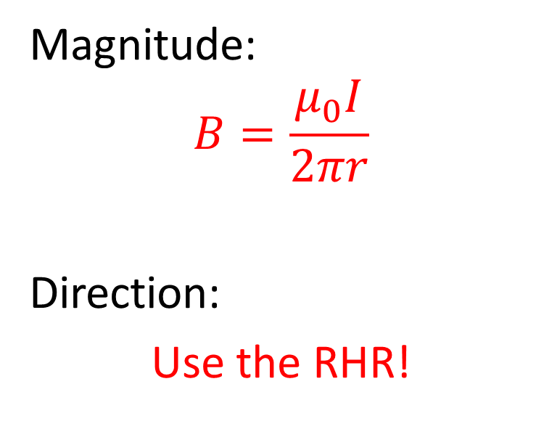
The Magnetic Field: Infinite Straight Wire
Magnitude:
$$B=\frac{μ_{0}I}{2πr}$$
Direction:
Use the RHR!

Slide 6
Example Problem: Infinite Wire

Slide 7
Activity: Magnetic Fields due to two wires

Slide 8
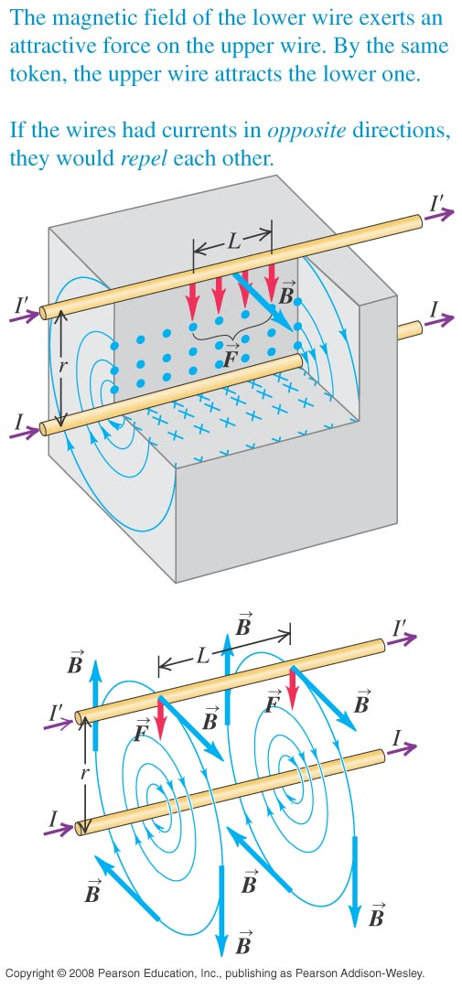
Two wires and the magnetic force!

Slide 9
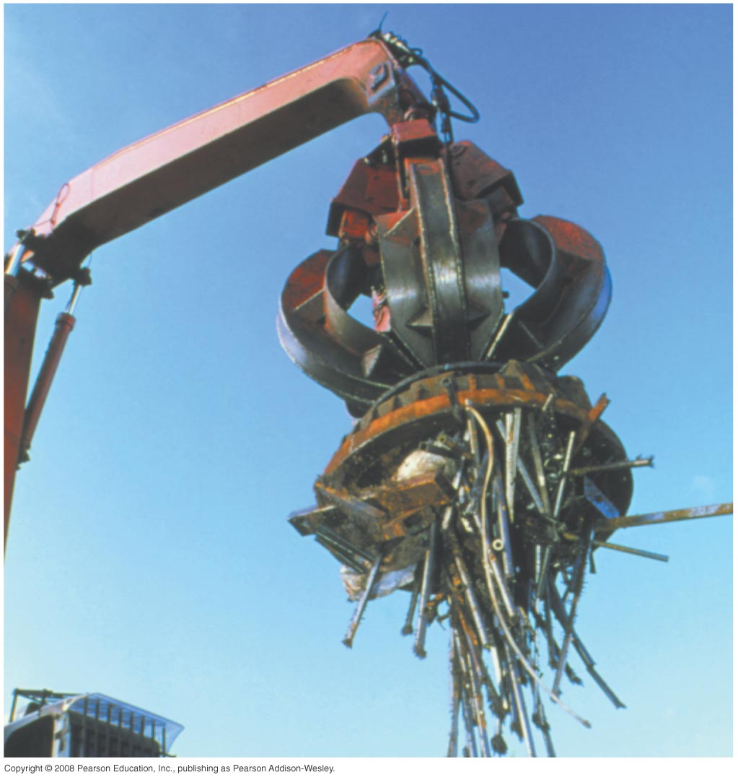
Magnetic field of a circular current loop

Slide 10
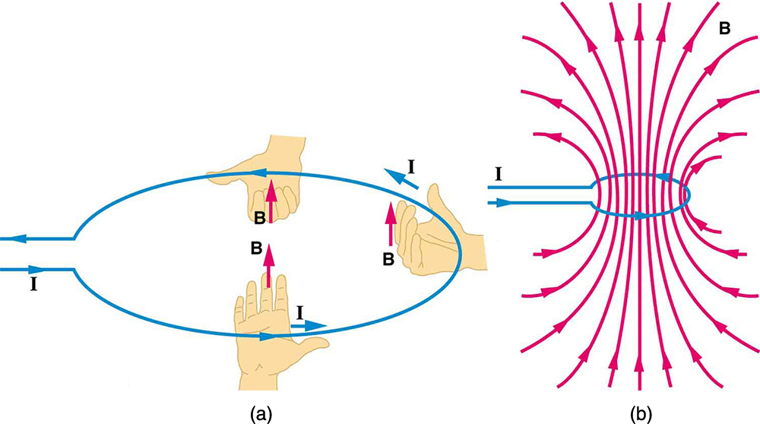
RHR for a Circular Current Loop

Slide 11
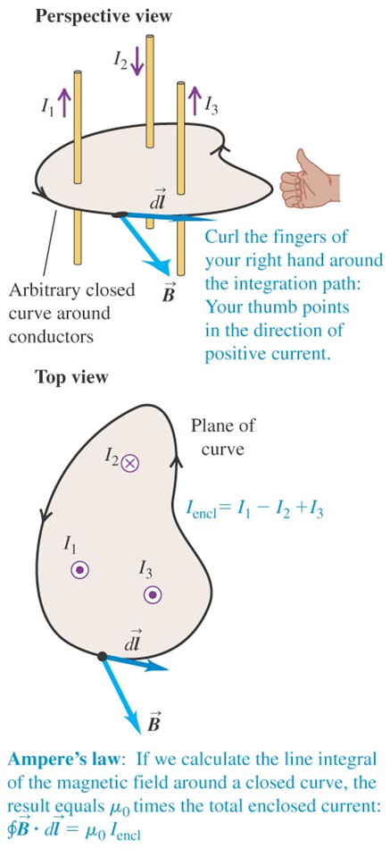

Ampere’s Law
$$\oint{\vec{B}·d\vec{l}}=μ_{0}I_{encl}$$

Slide 12
Ampere’s Law
Very useful in situations with lots of symmetry!
Infinite straight conductor
Infinite Solenoid

Slide 13
Example of Ampere’s Law: An Infinite 1D Wire

Slide 14
Activity: Ampere’s Law

Slide 15
Example of Ampere’s Law: Infinite Solenoid

Slide 16
Magnetic Materials
Three general types of materials
Paramagnetic materials
Diamagnetic materials
Ferromagnetic materials

Slide 17
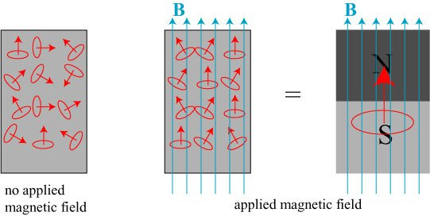
Paramagnets

Slide 18
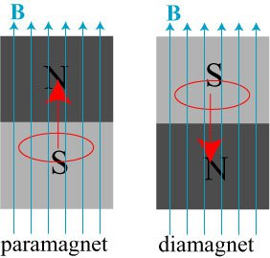
Diamagnets vs. Paramagnets

Slide 19
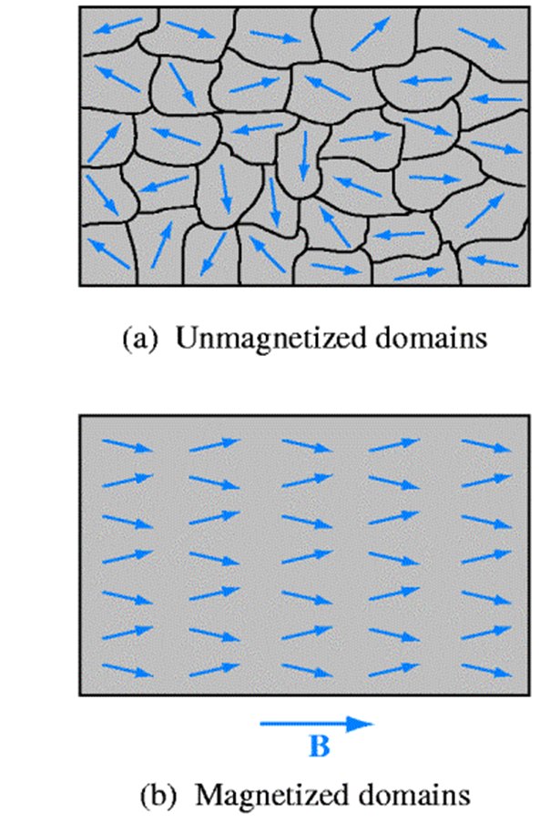
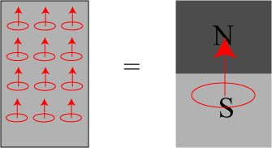
Ferromagnets

Slide 20
Magnetization Summary
Effect on applied magnetic field?
Paramagnets = small increase
Diamagnets = small decrease
Ferromagnets = HUGE increase

Slide 21

Relative Permeability
$$K_{m}≡\frac{B}{B_{0}}$$

Slide 22
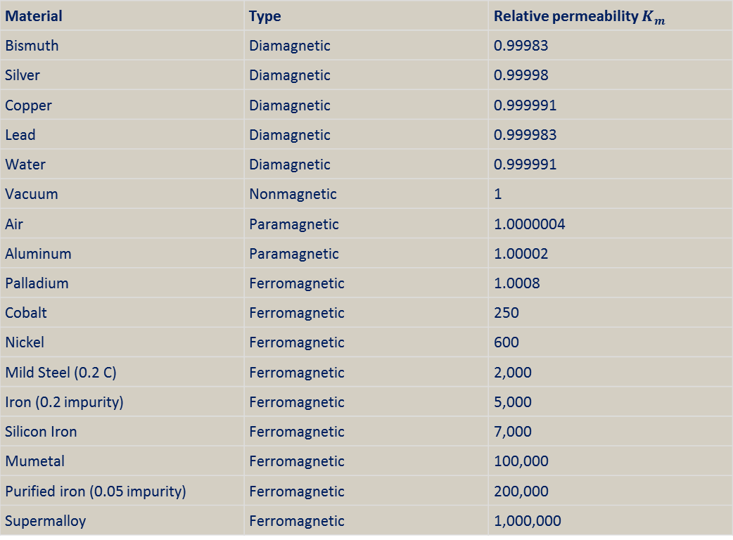
Relative Permeability Values
Material | Type | Relative permeability $K_{m}$
Bismuth | Diamagnetic | 0.99983
Silver | Diamagnetic | 0.99998
Copper | Diamagnetic | 0.999991
Lead | Diamagnetic | 0.999983
Water | Diamagnetic | 0.999991
Vacuum | Nonmagnetic | 1
Air | Paramagnetic | 1.0000004
Aluminum | Paramagnetic | 1.00002
Palladium | Ferromagnetic | 1.0008
Cobalt | Ferromagnetic | 250
Nickel | Ferromagnetic | 600
Mild Steel (0.2 C) | Ferromagnetic | 2,000
Iron (0.2 impurity) | Ferromagnetic | 5,000
Silicon Iron | Ferromagnetic | 7,000
Mumetal | Ferromagnetic | 100,000
Purified iron (0.05 impurity) | Ferromagnetic | 200,000
Supermalloy | Ferromagnetic | 1,000,000
http://www.microwaves101.com/microwave-encyclopedia/382-magnetic-materials

Slide 23

Permeability
$$μ≡μ_{0}K_{m}$$
Inside a material, can replace $μ_{0}$ with $μ$!

